Slide 1



Real-time Computer Vision
on Quadcopters
Names: Erick Garcia
Project group: Computer Graphics Laboratory
Mentors: Patrick Hanrahan, Jonathan Ragan-Kelley, Niels Joubert.

Slide 2
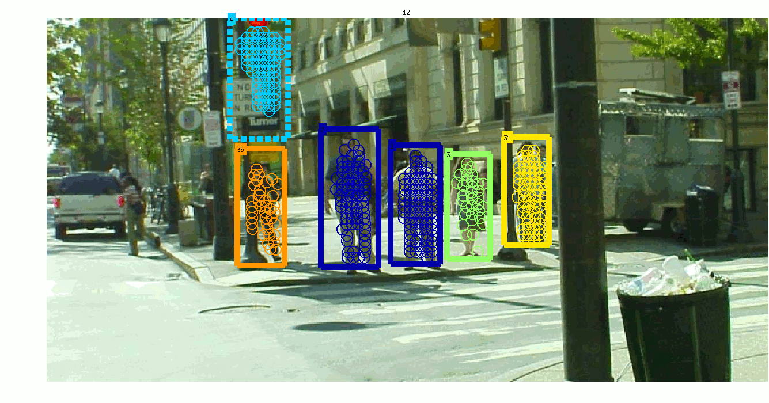
Computer Vision
Fig. Different people being recognized as separate objects by a camera
Notes:
Computer vision is a field that includes methods for acquiring, processing, analyzing, and understanding images and, in general, high-dimensional data from the real world in order to produce numerical or symbolic information, e.g., in the forms of decisions.^{[1][2][3][4]} A theme in the development of this field has been to duplicate the abilities of human vision by electronically perceiving and understanding an image.^{[5]}

Slide 3
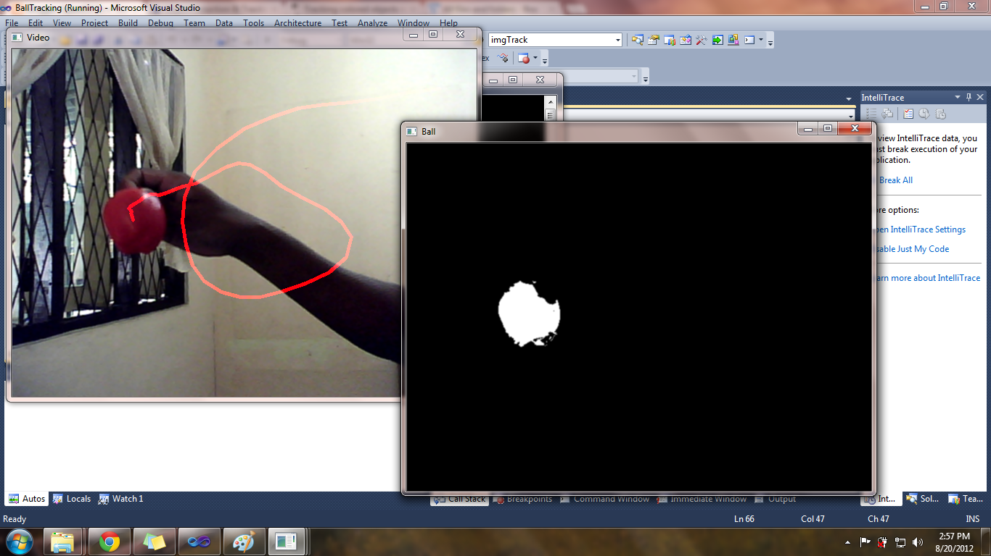
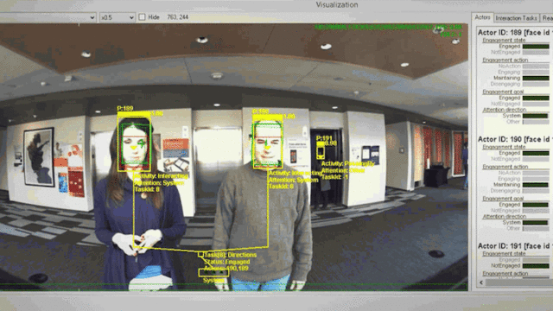
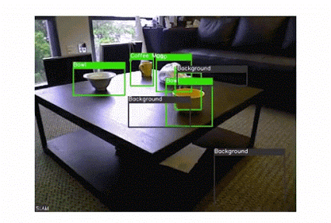
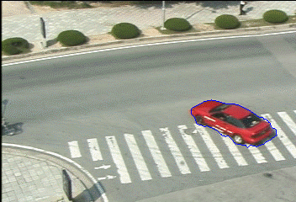
Image Processing
Converting to Digital Form, and perform operations in it.
Import (input)
Analyze and Manipulate
Return an output.
Input: Image or Video
Output: Image, or characteristics from the image.
Notes:
Converting to Digital Form, and perform operations in it.
Transformations
Obtain certain characteristics from an image
Input: Image or Video
Output: Image, or characteristics from the image.
image processing- title says that it processes image, means does some transformations on image. that means may be it does some smoothing,sharpening, contrasting,stretching.. on the image for making image more enhancive & readable that is input and output of a process are images.
computer vision -> the ultimate goal is to use computers to emulate human vision, including learning and being able to make inferences and take actions based on visual inputs

Slide 4
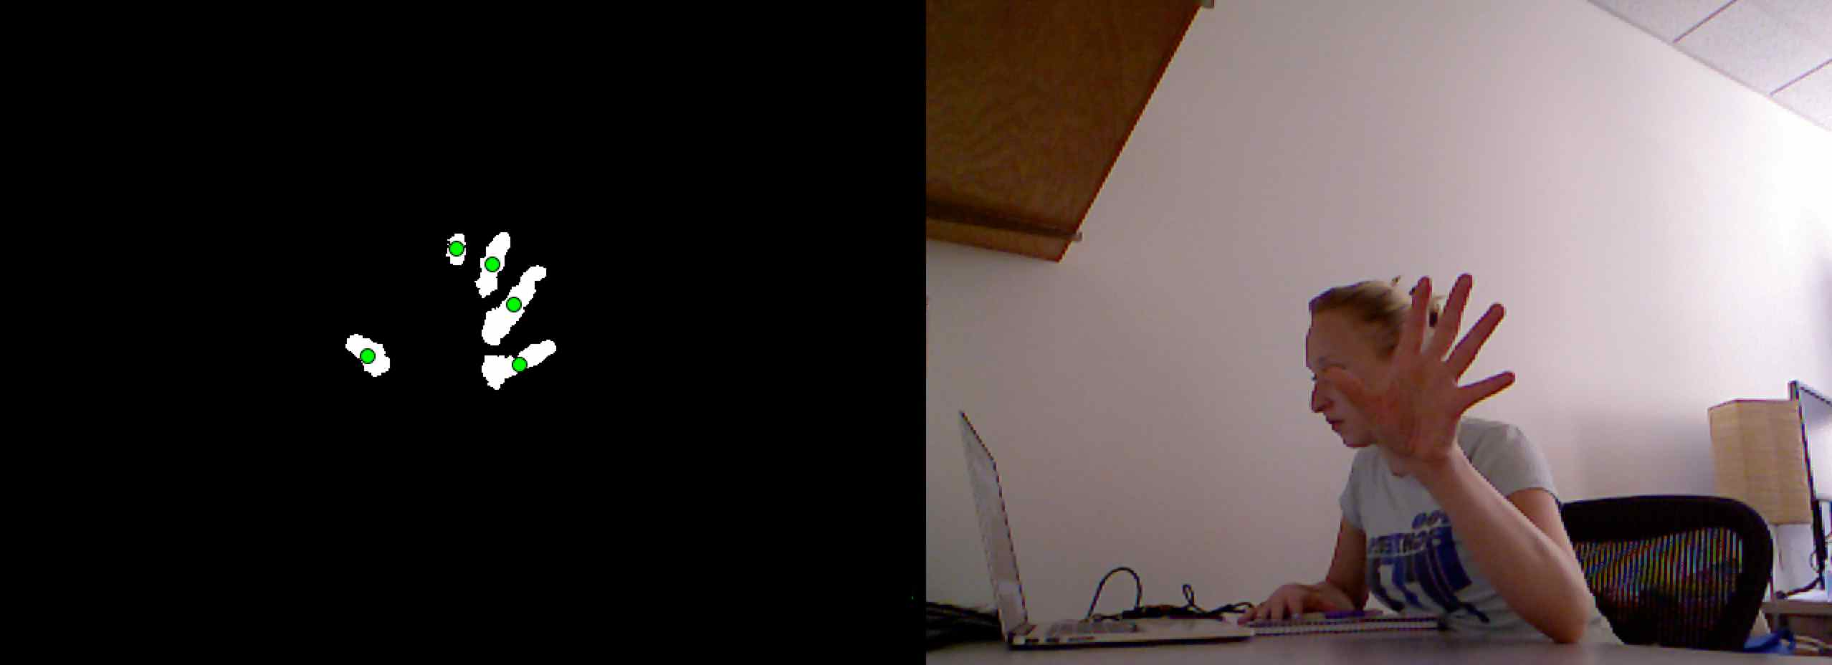
Image Processing
Challenges & Applications
Applications
Navigation
Detecting
Interaction
Automatic
Challenges
Which image components “belong together”?
How can objects be recognised without focusing on detail?
Fig. Abstraction and segmentation of a human
hand with xx filter
Notes:
Navigation, e.g., by an autonomous vehicle or mobile robot;
Detecting events, e.g., for visual surveillance or people counting;
Interaction, e.g., as the input to a device for computer-human interaction, and
Automatic inspection, e.g., in manufacturing applications.

Slide 5
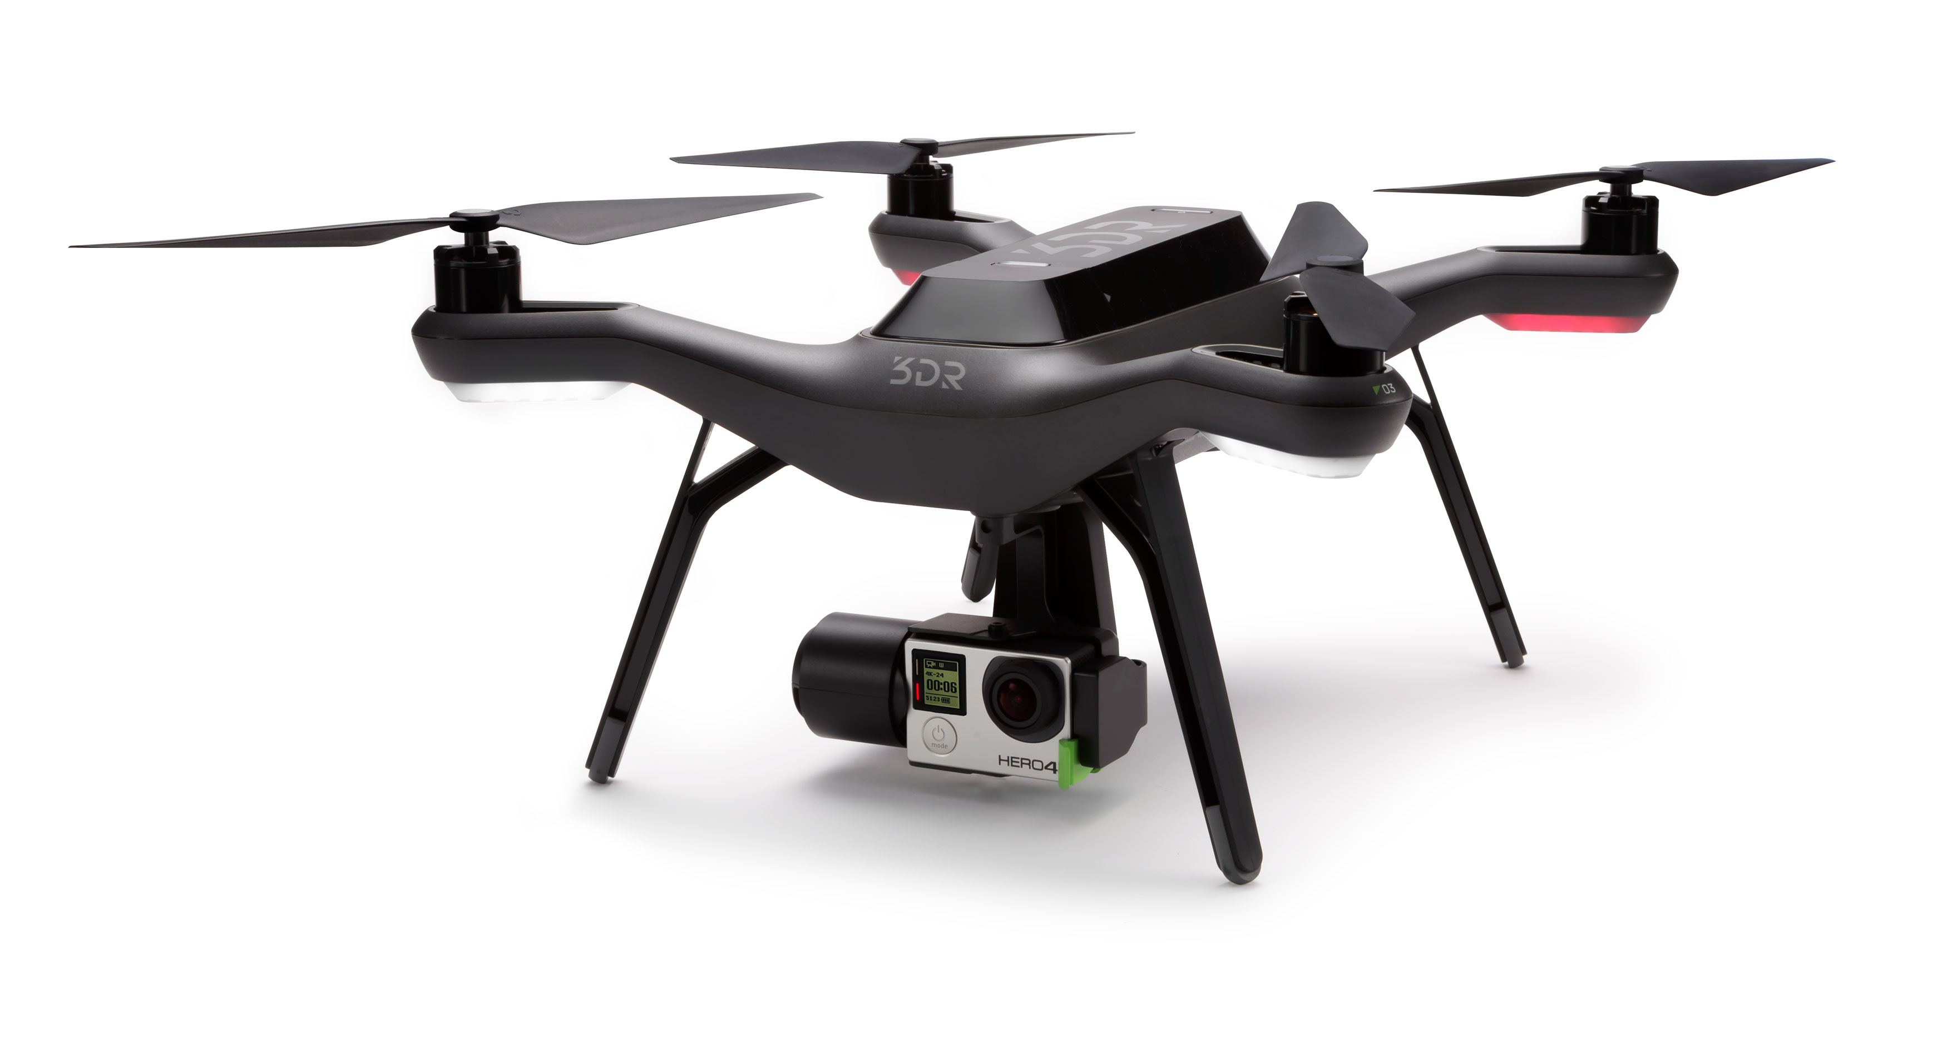
3DR Solo
Fig. 3DR’s Quadcopter the Solo Smart Drone

Slide 6
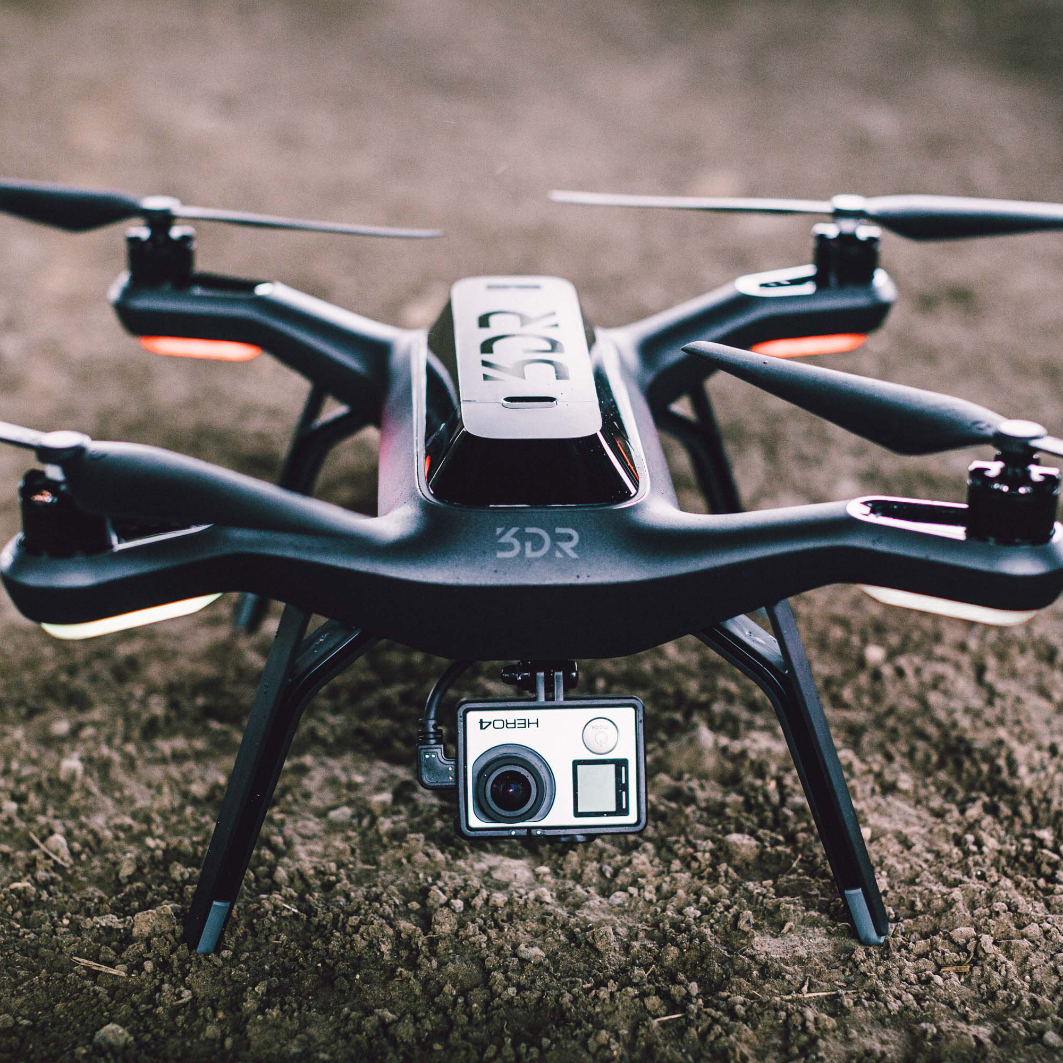
3DR Solo
Specifications:
OS: 3DR Poky (based on Yocto
Project Reference Distro) 1.5.1
CPU: ARMv7 Processor
Camera: GoPro® Hero4
HDMI Decoder: i.MX6 (h.264 encode/gstreamer)
Autopilot: Pixhawk 2

Slide 7
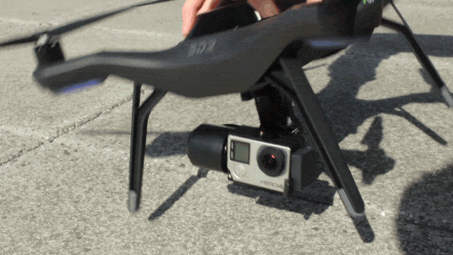
3DR Solo
Fig. 3DR Solo Gimball stabilizing GoPro Hero4

Slide 8
Objective
Load an image processing pipeline/library in the ARM Central Processing Unit that will enable developers to load custom code to unleash the 3DR Solo’s potential. To go from a real-time video streaming to real-time image processing, thus making the 3DR Solo, the first true smart drone.
Notes:
The first drone with a brain, Solo is powered by twin computers
Only drone to stream live HD video from GoPro® direct to iOS/Android devices
Revolutionary, intuitive video game-style controller
Take to the air in seconds with effortless pushbutton flight
Powerful Smart Shot technology makes capturing incredible cinematic footage easy and automatic
Unique safety features like pause and “safety net” mean you can fly with confidence
First with in-flight GoPro® access: Start/stop recording and adjust camera settings from the ground (with Solo Gimbal)
Full-featured app for iOS and Android puts total craft control at your fingertips
Follow Me mode enables Solo to automatically track and film any subject
Solo Gimbal (sold separately) delivers smooth footage, GoPro® power and control and HDMI video
Future-proof accessory and gimbal bays make Solo ready for tomorrow’s technology
Free software and feature updates ensure your Solo evolves at the pace of innovation
The smart drone keeps getting smarter: LiDAR for super stable indoor flight; ballistic parachute system; flight rewind and more, all scheduled for release
World-class customer support means we’ve always got your back: live six-day-a-week phone support from qualified engineers; in-app service tickets; and a 30-day money-back guarantee

Slide 9
Technical Challenges
Not knowing anything about the 3DR Solo except the information available to the public such as the user manual, and the specs of the device.
The Solo does not have the option to connect to the internet.
Our environment did not have gcc or any way to build it into the 3DR.
These problems would be more easily solvable if the code was Open Source sadly this last release was Closed Source.

Slide 10
Methodology
Talking with the 3DR Solo’s developers.
SSH (Secure Shell) into the 3DR Solo
Research about potentially useful image processing pipelines/libraries.
Design a workaround for embedding custom code.
Create a Custom Yocto Project Image with our needs.
Cross compile the custom code, and execute.
Notes:
Talking with the 3DR Solo’s developers to obtain root access to the drone
SSH (Secure Shell) into the 3DR Solo with the objective to figure out the custom linux distribution they are using and how they transmit their video.
Research about potentially useful image processing pipelines/libraries.
Design a workaround for getting the obtained image processing pipelines/libraries embedded into the 3DR Solo.
Create a Custom Yocto Project Image with our needs. (A matching ARM architecture, potentially a package manager and a C++ compiler)
Cross compile the custom code then transfer the executable image processing files into the 3DR Solo.

Slide 11
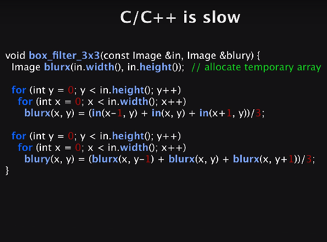
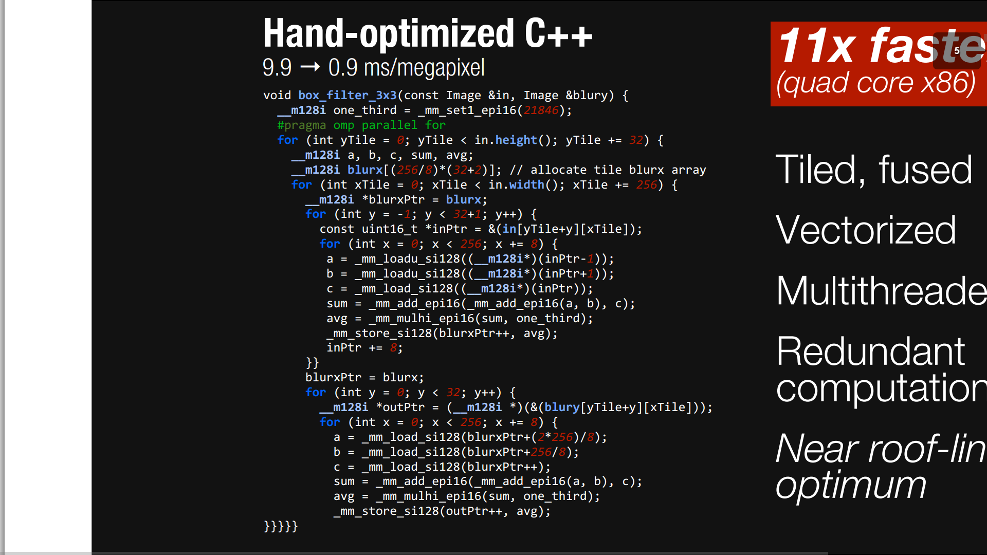
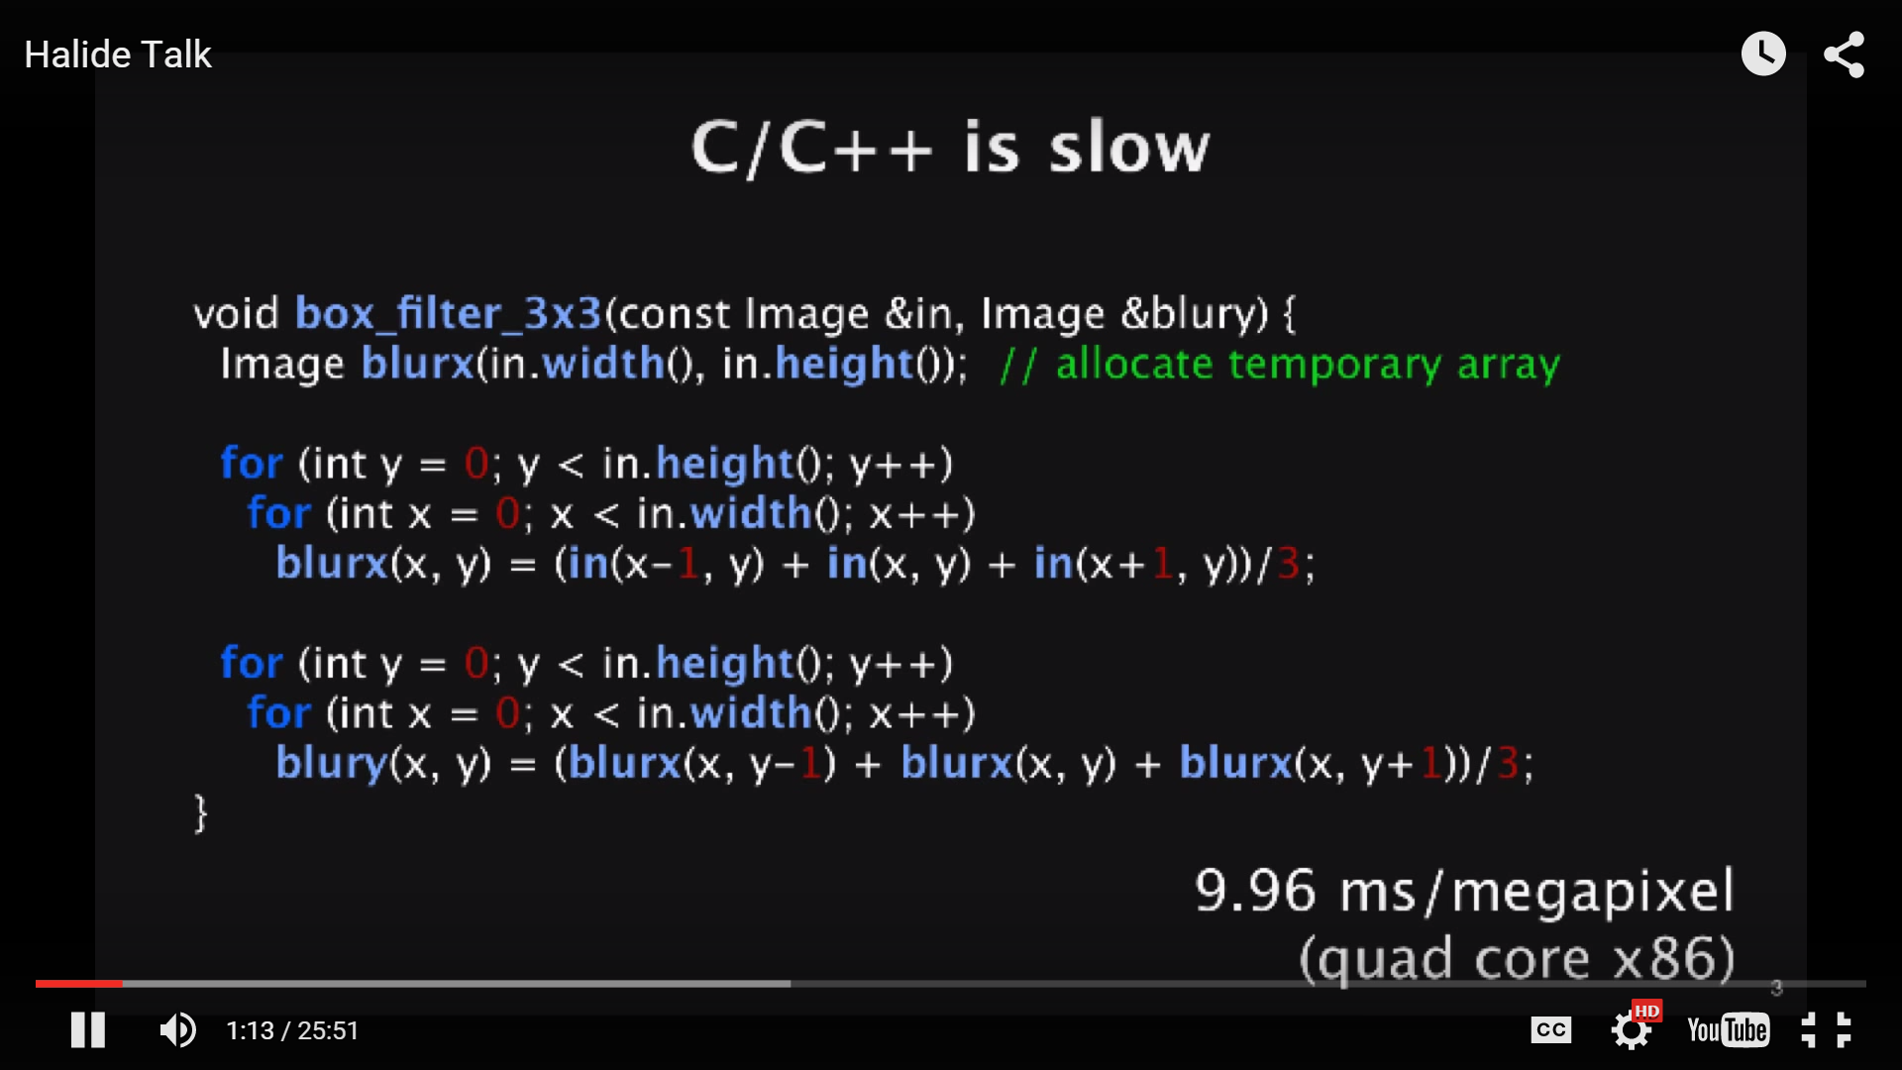
Halide
Halide:
A new programming language embedded in C++. It is a pipeline designed to make it easier to write high performance image procesing code on modern machines.
Fig. Comparing the speed of un-optimized image processing code (9.96 ms/mp) vs optimized code (0.9 ms/mp)
Notes:
The C hand optimized is Tiled, Fused, Vectorized, Multithreaded, redundant computations, etc.

Slide 12
Halide
The resulting code is:
Simple
Well Structured
Easy to read
Efficient
Fig. Comparing the speed of un-optimized image processing code (9.96 ms/mp) vs optimized code (0.9 ms/mp)
Notes:
The C hand optimized is Tiled, Fused, Vectorized, Multithreaded, redundant computations, etc.

Slide 13
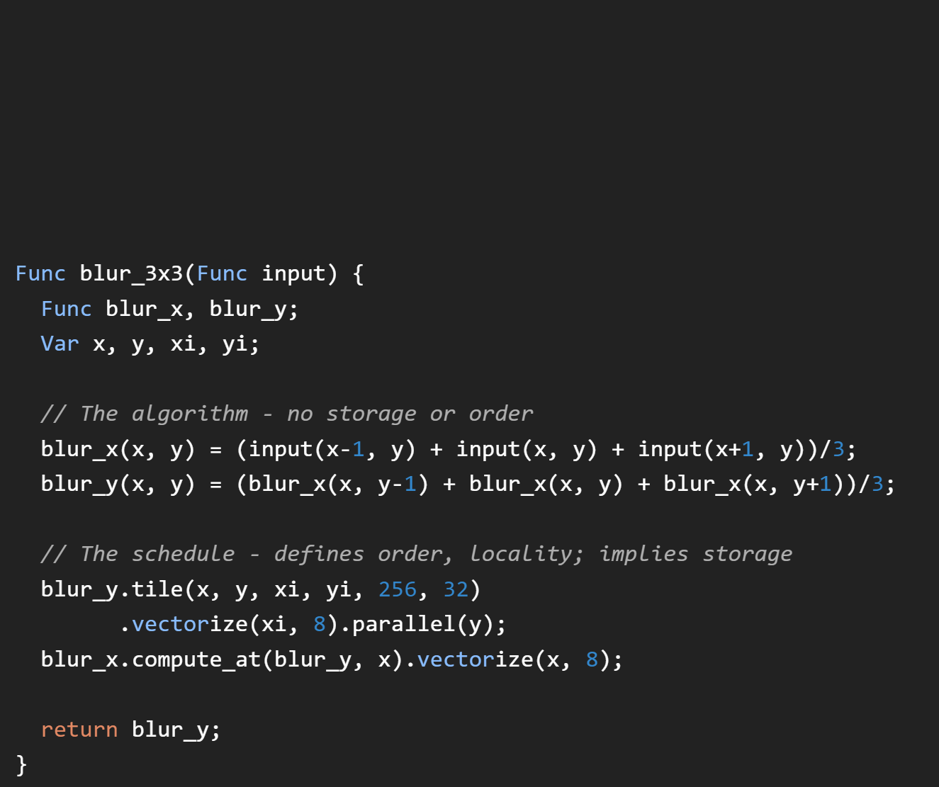
Halide
Halide
0.9 ms/Megapixel
Fig. Comparing Halide optimized code
vs Hand-optimized C++ code

Slide 14
Results
A method of getting custom image processing code running in the ARM processor of the 3DR Solo, for the purpose of achieving Real-time Computer Vision. This opens up a whole new level of possibilities of image processing and drones in general. All the possible practical applications for the truly first Smart Drone.

Slide 15
Future Work?

Slide 16
Thank you
I wish to sincerely thank the Army High Parallel Computing Center for providing us with this wonderful research opportunity and all the knowledge I got from this experience.

